Slide 1
Using JSatTrak as a Visualization Tool
Michael Mascaro
Virginia Tech Class of 2013

Slide 2
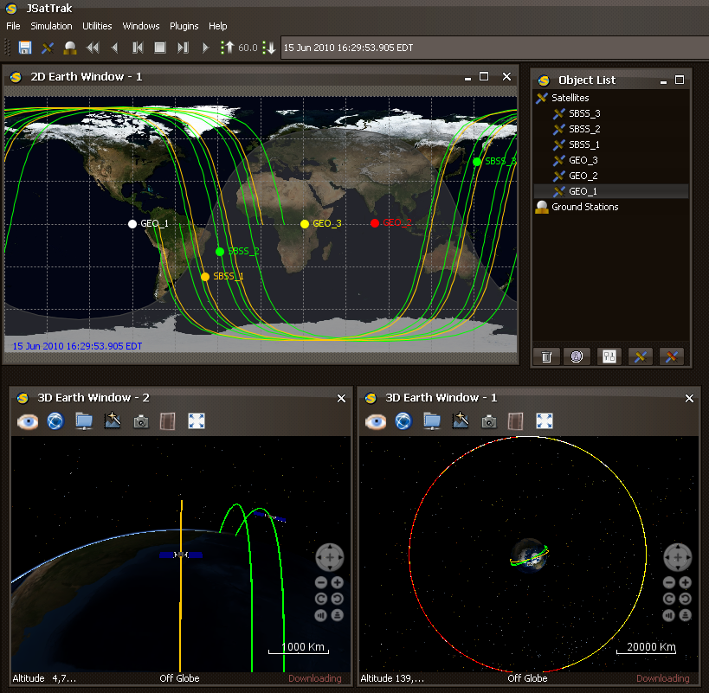
What is JSatTrak?
Satellite tracking program written in Java
Open source, free for use
Uses NASA World Wind for 3D graphics
Can be integrated with CCS and distributed with analysis

Slide 3
JSatTrak Visual Capabilities
Plots multiple satellites in both 2D and 3D windows
3D windows can use both inertial and fixed view modes
Use of 3D models and model-centered view modes with 3D graphics
Reads STK formatted ephemeris files

Slide 4
Applications of JSatTrak
Use JSatTrak as a download that runs off the website
Displays both 2D and 3D visualizations
Fast loading of visualizations
Interactive features similar to that of Google Earth
  Zoom, shift views, play forwards, backwards, change step size, etc.

Slide 5
Integrating JSatTrak
User requests information, including visualization requirements (view modes, windows, size, etc)
FreeFlyer processes data, creates ephemeris files
Script (Python) reads user inputs, ephemeris files and creates a JSatTrak (.jst) scenario
JSatTrak opens scenario

Slide 6
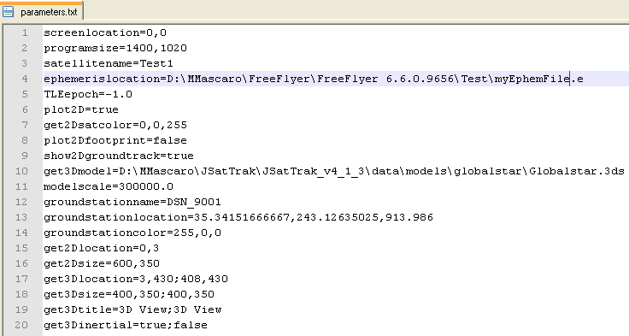
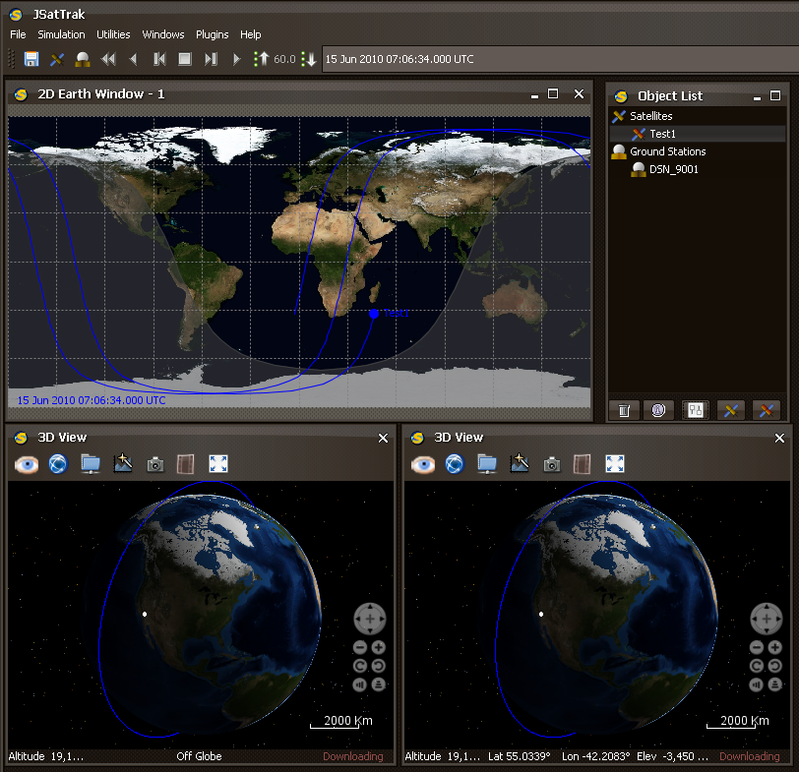
Integration Flowchart
User Input
FreeFlyer
Python Script
JSatTrak

Slide 7
Python Script
Consists of six functions:
  Zip_reader: reads the input template file
  Input_reader: reads the input parameters file
  Jul: calculates the correct epoch and other time values used in the scenario
  Groundstation_entry: creates the segment of the file containing ground stations
  Satellite_entry: creates the segment of the file containing satellites
  Scenario_creator: uses these functions to create the scenario file in JSatTrak format

Slide 8
Currently Required Files
Parameters.txt – contains user requirements for visualization
Ephemeris.e – ephemeris data for desired spacecraft
Template.jst – zipped template scenario from JSatTrak
Spacecraft.xml – template spacecraft information from JSatTrak

Slide 9
Today’s Demonstration
FreeFlyer creation of an ephemeris file
Artificially generated “user inputs” and ephemeris combined using Python script
Scenario viewed through JSatTrak
Future developments!
Currently all processes are done locally

Slide 10
The Next Step
Development of a faster, simpler method using built-in startup scripts
Removes the use of Python scripts and generated scenario files
Custom script for each scenario generates a different output based on user requirements
Currently in development- not all features finalized

